Slide 1
Wireless and mobile networks

Slide 2
Wireless and Mobile Networks
Background:
# wireless (mobile) phone subscribers now exceeds # wired phone subscribers (5-to-1)!
# wireless Internet-connected devices equals # wireline Internet-connected devices
laptops, Internet-enabled phones promise anytime untethered Internet access
two important (but different) challenges
wireless: communication over wireless link
mobility: handling the mobile user who changes point of attachment to network

Slide 3



















Elements of a wireless network
network
infrastructure

Slide 4



Elements of a wireless network
wireless hosts
laptop, smartphone
run applications
may be stationary (non-mobile) or mobile
wireless does not always mean mobility
network
infrastructure
Notes:
The slide shows the setting in which we’ll consider the topics of wireless data communication and mobility. We’ll begin by keeping our discussion general enough to cover a wide range of networks,
including both wireless LANs such as IEEE 802.11 and cellular networks such as a 4G network. We can identify the following elements in a wireless network:
Wireless hosts. As in the case of wired networks, hosts are the end-system devices that run applications. A wireless host might be a laptop, tablet, smartphone, or desktop computer. The hosts
themselves may or may not be mobile.

Slide 5

Elements of a wireless network
base station
typically connected to wired network
relay - responsible for sending packets between wired network and wireless host(s) in its “area”
e.g., cell towers, 802.11 access points
network
infrastructure
Notes:
Base station. The base station is a key part of the wireless network infrastructure. Unlike the wireless host and wireless link, a base station has no obvious counterpart in a wired network. A base
station is responsible for sending and receiving data (e.g., packets) to and from a wireless host that is associated with that base station. A base station will often be responsible for coordinating the transmission of multiple wireless hosts with which it is associated. When we say a wireless host is “associated” with a base station, we mean that (1) the host is within the wireless communication distance of the base station, and (2) the host uses that base station to relay data between it (the host) and the larger network. Cell towers in cellular networks and access points in 802.11 wireless LANs are examples of base stations.
In the slide the base station is connected to the larger network (e.g., the ­Internet, corporate or home network, or telephone network), thus functioning as a link-layer relay between the wireless
host and the rest of the world with which the host communicates.

Slide 6
Elements of a wireless network
wireless link
typically used to connect mobile(s) to base station
also used as backbone link
multiple access protocol coordinates link access
various data rates, transmission distance
network
infrastructure
Notes:
Hosts associated with a base station are often referred to as operating in ­infrastructure mode, since all traditional network services (e.g., address assignment and routing) are provided by the network to which a host is connected via the base station. In ad hoc networks, wireless hosts have no such infrastructure with which to connect. In the absence of such infrastructure, the hosts themselves must provide for services such as routing, address assignment, DNS-like name translation, and more.
When a mobile host moves beyond the range of one base station and into the range of another, it will change its point of attachment into the larger network (i.e., change the base station with which it is associated)—a process referred to as handoff. Such mobility raises many challenging questions. If a host can move, how does one find the mobile host’s current location in the network so that data can be forwarded to that mobile host? How is addressing performed, given that a host can be in one of many possible locations? If the host moves during a TCP connection or phone call, how is data routed so that the connection continues uninterrupted? These and many (many!) other questions make wireless and mobile networking an area of exciting networking research.
Network infrastructure. This is the larger network with which a wireless host may wish to communicate.

Slide 7
Characteristics of selected wireless links
1300
802.11 ac
450
802.11n
54
802.11a,g
802.11a,g point-to-point
5-11
802.11b
4G: LTWE WIMAX
4
3G: UMTS/WCDMA-HSPDA, CDMA2000-1xEVDO
Data rate (Mbps)
1
802.15
.384
2.5G: UMTS/WCDMA, CDMA2000
.056
2G: IS-95, CDMA, GSM
Indoor
10-30m
Outdoor
50-200m
Mid-range
outdoor
200m – 4 Km
Long-range
outdoor
5Km – 20 Km
Notes:
Wireless links. A host connects to a base station (defined below) or to another wireless host through a wireless communication link. Different wireless link technologies have different
transmission rates and can transmit over different distances. The slide shows two key characteristics (coverage area and link rate) of the more popular wireless network standards. (The
figure is only meant to provide a rough idea of these characteristics. For example, some of these types of networks are only now being deployed, and some link rates can increase or decrease beyond the values shown depending on distance, channel conditions, and the number of users in the wireless network.)

Slide 8
Wireless network taxonomy
single hop
multiple hops
host connects to
base station (WiFi,
WiMAX, cellular)
which connects to
larger Internet
host may have to
relay through several
wireless nodes to
connect to larger
Internet: mesh net
infrastructure
(e.g., APs)
no base station, no
connection to larger
Internet. May have to
relay to reach other
a given wireless node
MANET, VANET
no
infrastructure
no base station, no
connection to larger
Internet (Bluetooth,
ad hoc nets)
Notes:
Having discussed the “pieces” of a wireless network, we note that these pieces can be combined in many different ways to form different types of wireless networks. You may find a taxonomy of these types of wireless networks useful as you read on in this chapter, or read/learn more about wireless networks beyond the core text book. At the highest level we can classify wireless networks according to two
criteria: (i) whether a packet in the wireless network crosses exactly one wireless hop or multiple wireless hops, and (ii) whether there is infrastructure such as a base station in the network:
Single-hop, infrastructure-based. These networks have a base station that is connected to a larger wired network (e.g., the Internet). Furthermore, all communication is between this base station
and a wireless host over a single wireless hop. The 802.11 networks you use in the classroom, café, or library; and the 4G LTE data networks that we will learn about shortly all fall in this category. The vast majority of our daily interactions are with single-hop, infrastructure-based ­wireless networks.
Single-hop, infrastructure-less. In these networks, there is no base station that is connected to a wireless network. However, as we will see, one of the nodes in this single-hop network may
coordinate the transmissions of the other nodes. ­Bluetooth networks (that connect small wireless
devices such as keyboards, speakers, and headsets, and 802.11 networks in ad hoc mode are single-hop, infrastructure-less networks.
Multi-hop, infrastructure-based. In these networks, a base station is present that is wired to the larger network. However, some wireless nodes may have to relay their communication through other
wireless nodes in order to communicate via the base station. Some wireless sensor networks and so-called wireless mesh networks fall in this category.
Multi-hop, infrastructure-less. There is no base station in these networks, and nodes may have to relay messages among several other nodes in order to reach a destination. Nodes may also be
mobile, with connectivity changing among nodes—a class of networks known as mobile ad hoc networks (MANETs). If the mobile nodes are vehicles, the network is a vehicular ad hoc network (VANET). As you might imagine, the development of protocols for such networks is challenging and is the subject of much ongoing research.

Slide 9
Wireless Link Characteristics (1)
important differences from wired link ….
decreased signal strength: radio signal attenuates as it propagates through matter (path loss)
interference from other sources: standardized wireless network frequencies (e.g., 2.4 GHz) shared by other devices (e.g., phone); devices (motors) interfere as well
multipath propagation: radio signal reflects off objects ground, arriving ad destination at slightly different times
…. make communication across (even a point to point) wireless link much more “difficult”
Notes:
Let’s begin by considering a simple wired network, say a home network, with a wired Ethernet switch interconnecting the hosts. If we replace the wired Ethernet with a wireless 802.11 network, a wireless network interface would replace the host’s wired Ethernet interface, and an access point would replace the Ethernet switch, but virtually no changes would be needed at the network layer or above. This suggests that we focus our attention on the link layer when looking for important differences between wired and wireless networks. Indeed, we can find a number of important differences between a wired link and a wireless link:
Decreasing signal strength. Electromagnetic radiation attenuates as it passes through matter (e.g., a radio signal passing through a wall). Even in free space, the signal will disperse, resulting in
decreased signal strength (sometimes referred to as path loss) as the distance between sender and receiver increases.
Interference from other sources. Radio sources transmitting in the same frequency band will interfere with each other. For example, 2.4 GHz wireless phones and 802.11b wireless LANs
transmit in the same frequency band. Thus, the 802.11b wireless LAN user talking on a 2.4 GHz wireless phone can expect that neither the network nor the phone will perform particularly well. In addition to interference from transmitting sources, electromagnetic noise within the environment (e.g., a nearby motor, a microwave) can result in interference.
Multipath propagation. Multipath propagation occurs when portions of the electromagnetic wave reflect off objects and the ground, taking paths of different lengths between a sender and receiver.
This results in the blurring of the received signal at the receiver. Moving objects between the sender and receiver can cause multipath propagation to change over time.

Slide 10
Wireless Link Characteristics (2)
SNR: signal-to-noise ratio
larger SNR – easier to extract signal from noise (a “good thing”)
SNR versus BER tradeoffs
given physical layer: increase power -> increase SNR->decrease BER
given SNR: choose physical layer that meets BER requirement, giving highest thruput
SNR may change with mobility: dynamically adapt physical layer (modulation technique, rate)
10⁻¹
10⁻²
10⁻³
BER
10⁻⁴
10⁻⁵
10⁻⁶
10⁻⁷
10
20
30
40
SNR(dB)
QAM256 (8 Mbps)
QAM16 (4 Mbps)
BPSK (1 Mbps)
Notes:
Having considered the impairments that can occur on a wireless channel, let’s next turn our attention to the host receiving the wireless signal. This host receives an electromagnetic signal that is a combination of a degraded form of the original signal transmitted by the sender (degraded due to the attenuation and multipath propagation effects among others) and background noise in the
environment.
The signal-to-noise ratio (SNR) is a relative measure of the strength of the received signal (i.e., the information being transmitted) and this noise. The SNR is typically measured in units of decibels (dB), a unit of measure that some think is used by electrical engineers primarily to confuse computer scientists. The SNR, measured in dB, is twenty times the ratio of the base-10 logarithm of the amplitude of the received signal to the amplitude of the noise. For our purposes here, we need only know that a larger SNR makes it easier for the receiver to extract the transmitted signal from the background noise.
The slide (adapted from [Holland 2001]) shows the bit error rate (BER)—roughly speaking, the probability that a transmitted bit is received in error at the receiver—versus the SNR for three different
modulation techniques for encoding information for transmission on an idealized wireless channel. The theory of modulation and coding, as well as signal extraction and BER, is well beyond the scope of
this text (see [Schwartz 1980] for a discussion of these topics). Nonetheless, the dslide illustrates several physical-layer characteristics that are important in understanding higher-layer wireless
communication protocols:

Slide 11

Wireless network characteristics
Multiple wireless senders and receivers create additional problems (beyond multiple access):
A
B
C
C
A’s signal
strength
C’s signal
strength
B
A
Hidden terminal problem
B, A hear each other
B, C hear each other
A, C can not hear each other means A, C unaware of their interference at B
space
Signal attenuation:
B, A hear each other
B, C hear each other
A, C can not hear each other interfering at B
Notes:
For a given modulation scheme, the higher the SNR, the lower the BER. Since a sender can increase the SNR by increasing its transmission power, a sender can decrease the probability that a
frame is received in error by increasing its transmission power. Note, however, that there is arguably little practical gain in increasing the power beyond a certain threshold, say to decrease the BER from
10−12 to 10−13. There are also disadvantages associated with increasing the transmission power: More energy must be expended by the sender (an important concern for battery-powered mobile
users), and the sender’s transmissions are more likely to interfere with the transmissions of another
sender For a given SNR, a modulation technique with a higher bit transmission rate (whether in error
or not) will have a higher BER. For example, with an SNR of 10 dB, BPSK modulation with a transmission rate of 1 Mbps has a BER of less than 10−7, while with QAM16
modulation with a transmission rate of 4 Mbps, the BER is 10−1, far too high to be practically useful. However, with an SNR of 20 dB, QAM16 modulation has a transmission rate of 4 Mbps and a BER of 10−7, while BPSK modulation has a transmission rate of only 1 Mbps and a BER that is so low as to be (literally) “off the charts.” If one can tolerate a BER of 10−7, the higher transmission rate offered by QAM16 would make it the preferred modulation technique in this situation. These considerations give rise to the final characteristic, described next.
Dynamic selection of the physical-layer modulation technique can be used to adapt the modulation technique to channel conditions. The SNR (and hence the BER) may change as a
result of mobility or due to changes in the environment. Adaptive modulation and coding are used in cellular data systems and in the 802.11 WiFi and 4G cellular data networks that we’ll study in
This allows, for example, the selection of a modulation technique that provides the highest transmission rate possible subject to a constraint on the BER, for given channel characteristics.
A higher and time-varying bit error rate is not the only difference between a wired and wireless link. Recall that in the case of wired broadcast links, all nodes receive the transmissions from all other nodes.
In the case of wireless links, the situation is not as simple, Suppose that Station A is transmitting to Station B. Suppose also that Station C is transmitting to Station B. With the so-called
hidden terminal problem, physical obstructions in the environment (for example, a mountain or a building) may prevent A and C from hearing each other’s transmissions, even though A’s and C’s
transmissions are indeed interfering at the destination, B. This is shown a scenario that results in undetectable collisions at the receiver results from the fading of a signal’s
strength as it propagates through the wireless medium. The slide illustrates the case where A and C are placed such that their signals are not strong enough to detect each other’s transmissions, yet their
signals are strong enough to interfere with each other at station, the hidden terminal problem and fading make multiple access in a wireless network considerably more complex than in a wired network.

Slide 12
Code Division Multiple Access (CDMA)
unique “code” assigned to each user; i.e., code set partitioning
all users share same frequency, but each user has own “chipping” sequence (i.e., code) to encode data
allows multiple users to “coexist” and transmit simultaneously with minimal interference (if codes are “orthogonal”)
encoded signal = (original data) X (chipping sequence)
decoding: inner-product of encoded signal and chipping sequence
Notes:
Recall from earlier weeks that when hosts communicate over a shared medium, a protocol is needed so that the signals sent by multiple senders do not interfere at the receivers. We previously described
three classes of medium access protocols: channel partitioning, random access, and taking turns. Code division multiple access (CDMA) belongs to the family of channel partitioning protocols. It is prevalent in wireless LAN and cellular technologies. Because CDMA is so important in the wireless world, we’ll take a quick look at CDMA now, before getting into specific wireless access technologies in the subsequent sections.

Slide 13
CDMA encode/decode
channel output Z_{i,m}
Z_{i,m}= d_{i}.c_{m}
data
bits
d₀ = 1
1
1
1
1
1
d₁ = -1
1
1
1
-
-
-
-
1
-
-
-
1
-
1
1
1
1
1
sender
1
1
slot 1
channel
output
slot 0
channel
output
1
1
1
1
1
code
1
1
-
-
-
1
-
1
1
1
-
-
-
1
-
1
1
1
slot 1
slot 0
M
D_{i} = Σ Z_{i,m}.c_{m}
m=1
M
received
input
1
1
1
1
1
1
1
1
d₀ = 1
-
-
-
-
1
-
-
-
1
-
1
1
1
1
1
1
d₁ = -1
1
slot 1
channel
output
slot 0
channel
output
1
1
1
1
1
code
1
1
-
-
-
1
-
1
1
1
-
-
-
1
-
1
1
1
receiver
slot 1
slot 0
Notes:
In a CDMA protocol, each bit being sent is encoded by multiplying the bit by a signal (the code) that changes at a much faster rate (known as the chipping rate) than the original sequence of data bits.
The slide shows a simple, idealized CDMA encoding/decoding scenario. Suppose that the rate at which original data bits reach the CDMA encoder defines the unit of time; that is, each original data bit to
be transmitted requires a one-bit slot time. Let di be the value of the data bit for the ith bit slot. For mathematical convenience, we represent a data bit with a 0 value as −1. Each bit slot is further
subdivided into M mini-slots; in the slide, M=8, although in practice M is much larger. The CDMA code used by the sender consists of a sequence of M values, cm, m=1,..., M, each taking a+1 or −1 value. In the example in the slide, the M-bit CDMA code being used by the sender is (1,1,1,−1,1,−1,−1,−1).
To illustrate how CDMA works, let us focus on the ith data bit, di. For the mth mini-slot of the bit- transmission time of di, the output of the CDMA encoder, Zi,m, is the value of di multiplied by the mth bit in the assigned CDMA code, cm:
Zi,m=di⋅cm
In a simple world, with no interfering senders, the receiver would receive the encoded bits, Zi,m, and recover the original data bit, di, by computing:
di=1M∑m=1MZi,m⋅cm
data bits are indeed correctly recovered at the receiver.

Slide 14
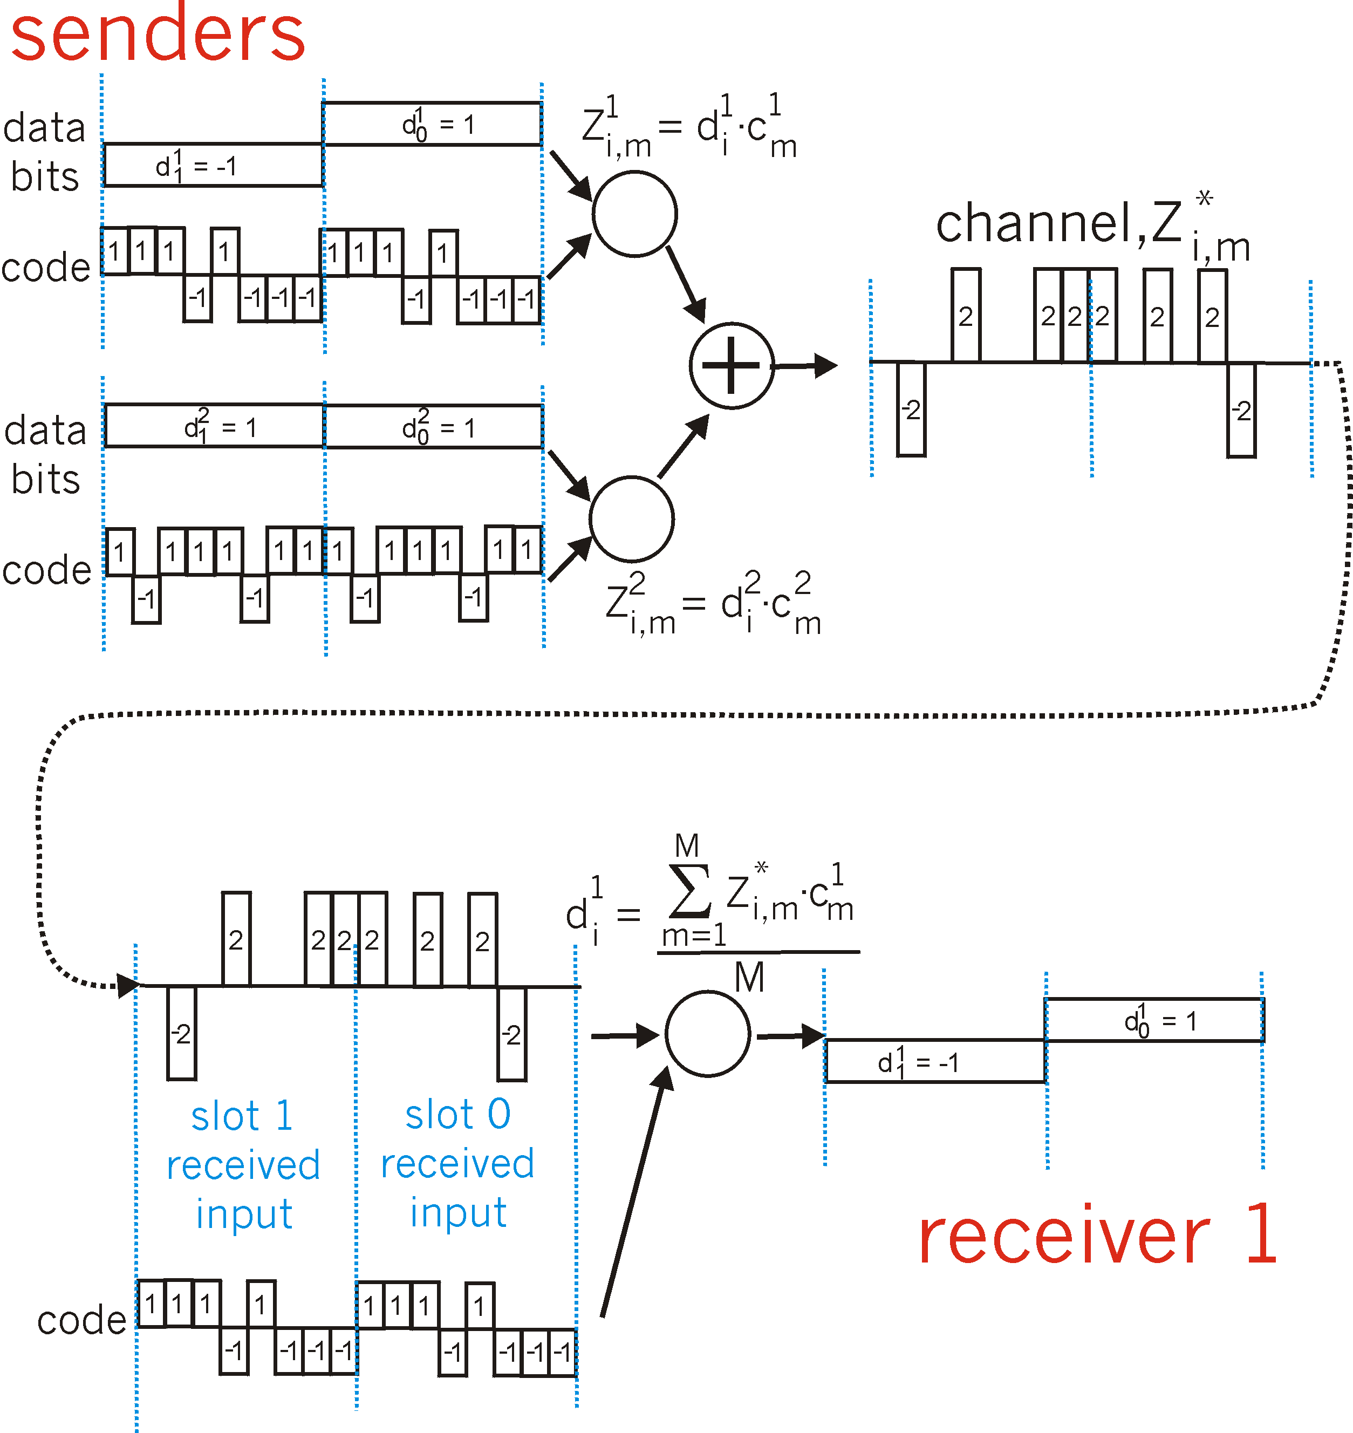
CDMA: two-sender interference
channel sums together transmissions by sender 1 and 2
Sender 1
Sender 2
using same code as sender 1, receiver recovers sender 1’s original data from summed channel data!
Notes:
CDMA must work in the presence of interfering senders that are encoding and transmitting their data using a different assigned code. But how can a CDMA receiver recover a sender’s original data bits when those data bits are being tangled with bits being transmitted by other senders? CDMA works under the assumption that the interfering transmitted bit signals are additive. This means, for example, that if three senders send a 1 value, and a fourth sender sends a −1 value during the same mini-slot, then the received signal at all receivers during
that mini-slot is a 2 (since 1+1+1−1=2). In the presence of multiple senders, sender s computes its encoded transmissions, Zi,ms, in exactly the same manner as in Equation 7.1. The value received at a receiver during the mth mini-slot of the ith bit slot, however, is now the sum of the transmitted bits from all N senders during that mini-slot:
Zi,m*=∑s=1NZi,ms
Amazingly, if the senders’ codes are chosen carefully, each receiver can recover the data sent by a given sender out of the aggregate signal simply by using the sender’s code in exactly the same manner
as in Equation : di=1M∑m=1MZi,m*⋅cm
as shown in the slide, for a two-sender CDMA example. The M-bit CDMA code being used by the upper sender is (1,1,1,−1,1,−1,−1,−1), while the CDMA code being used by the lower sender is
(1,−1,1,1,1,−1,1,1). The slide illustrates a receiver recovering the original data bits from the upper sender. Note that the receiver is able to extract the data from sender 1 in spite of the interfering
transmission from sender 2.
A CDMA protocol is similar to having partygoers speaking in multiple languages; in such circumstances humans are actually quite good at locking into the conversation in the language they understand, while filtering out the remaining conversations. We see here that CDMA is a partitioning protocol in that it partitions the code space (as opposed to time or frequency) and assigns each node a dedicated piece of the code space.

